Slide 1

FPT University
Android programMing
Lesson 19
Version 1.0

Slide 2
Agenda
Making Runtime Permission Requests
Android Audio Recording and Playback using MediaPlayer and MediaRecorder

Slide 3
Permission Requests
Permission request for the app to perform a specific task
There are a number of permissions for which additional steps are required in order for the app to function when running. The first of these so-called “dangerous” permissions.

Slide 4
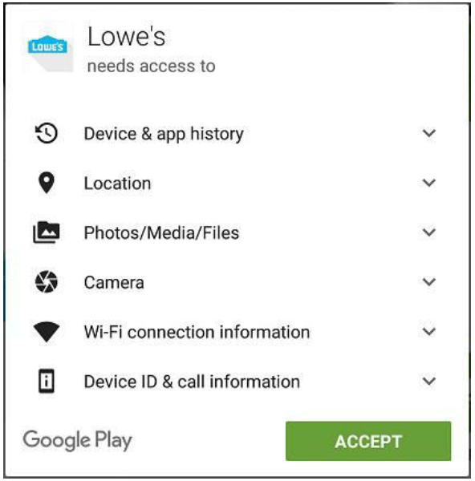
Permission Requests
Understanding Normal and Dangerous Permissions Android enforces security by requiring the user to grant permission for an app to perform certain tasks. Permission was always sought at the point that the app was installed on the device. These permissions are referred to as normal permissions and are still required to be accepted by the user at the point of installation

Slide 5
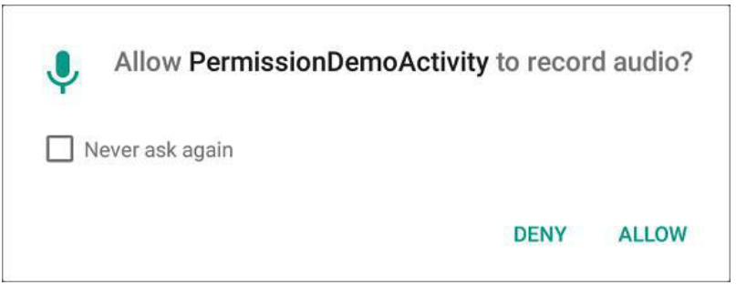
Permission Requests
Understanding Normal and Dangerous Permissions A second type of permission, referred to as dangerous permissions must also be declared within the manifest file in the same way as a normal permission, but must also be requested from the user when the application is first launched

Slide 6
Permission Requests
The list of permissions that fall into the dangerous category is https://developer.android.com/guide/topics/permissions/overview
Calendar | READ_CALENDAR WRITE_CALENDAR
Camera | CAMERA
Phone | READ_PHONE_STATE CALL_PHONE READ_CALL_LOG WRITE_CALL_LOG USE_SIP PROCESS_OUTGOING_CALLS
Microphone | RECORD_AUDIO
Contacts | READ_CONTACTS WRITE_CONTACTS GET_ACCOUNTS
Location | ACCESS_FINE_LOCATION ACCESS_COARSE_LOCATION
Sensors | BODY_SENSORS
SMS | SEND_SMS RECEIVE_SMS READ_SMS RECEIVE_WAP_PUSH RECEIVE_MMS
Storage | READ_EXTERNAL_STORAGE WRITE_EXTERNAL_STORAGE

Slide 7
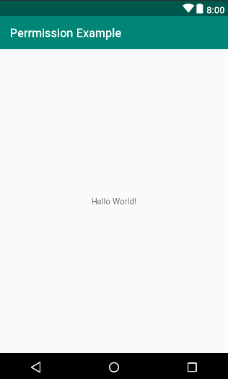
Permission Requests
Creating the Permissions Example Project

Slide 8
Permission Requests
Checking for a Permission
TextView textView = findViewById(R.id.textView); int permission = ContextCompat.checkSelfPermission(this, Manifest.permission.RECORD_AUDIO); if (permission != PackageManager.PERMISSION_GRANTED) { //Todo : Do somethings here textView.setText("permission.RECORD_AUDIO DENIED"); }

Slide 9
Permission Requests
Add permission in Manifest file
<?xml version="1.0" encoding="utf-8"?> <manifest xmlns:android="http://schemas.android.com/apk/res/android" package="com.example.fu.audioexample"> <uses-permission android:name="android.permission.RECORD_AUDIO"/> <uses-permission android:name="android.permission.READ_EXTERNAL_STORAGE"/> <uses-permission android:name="android.permission.WRITE_EXTERNAL_STORAGE"/> <application .......... </application> </manifest>

Slide 10
Permission Requests
Requesting Permission at Runtime A permission request is made via a call to the requestPermissions() method of the ActivityCompat class. When this method is called, the permission request is handled asynchronously and a method named onRequestPermissionsResult() is called when the task is completed.
int PERMISSION_ALL = 1; private void requestPermission(){ String[] PERMISSIONS = { Manifest.permission.RECORD_AUDIO, Manifest.permission.READ_EXTERNAL_STORAGE, Manifest.permission.WRITE_EXTERNAL_STORAGE }; ActivityCompat.requestPermissions(this, PERMISSIONS, PERMISSION_ALL); }

Slide 11
Permission Requests
Handle on result methods
@Override public void onRequestPermissionsResult(int requestCode, String permissions[], int[] grantResults) { switch (requestCode) { case PERMISSION_ALL: { if (grantResults.length == 0 || grantResults[0] != PackageManager.PERMISSION_GRANTED) { textView.setText("Permission has been denied by user"); } else { textView.setText("Permission has been granted by user"); } return; } } }

Slide 12
Permission Requests
Providing a Rationale for the Permission Request
User has the option to deny the requested permission. In this case, the app will continue to request the permission each time that it is launched by the user unless the use selected the “Never ask again” option prior to clicking on the Deny button.
Repeated denials by the user may indicate that the user doesn’t understand why the permission is required by the app. The user might be more likely to grant permission if the reason for the requirements is explained when the request is made

Slide 13
Permission Requests
if(permission != PackageManager.PERMISSION_GRANTED){ message += "\nRECORD_AUDIO permission not granted"; if (ActivityCompat.shouldShowRequestPermissionRationale(this, Manifest.permission.RECORD_AUDIO)) { AlertDialog.Builder builder = new AlertDialog.Builder(this); builder.setMessage("Permission to access the microphone is required for this app to record audio.") .setTitle("Permission required"); builder.setPositiveButton("OK", new DialogInterface.OnClickListener() { public void onClick(DialogInterface dialog, int id) { requestPermission(); } }); AlertDialog dialog = builder.create(); dialog.show(); } else { requestPermission(); } }

Slide 14
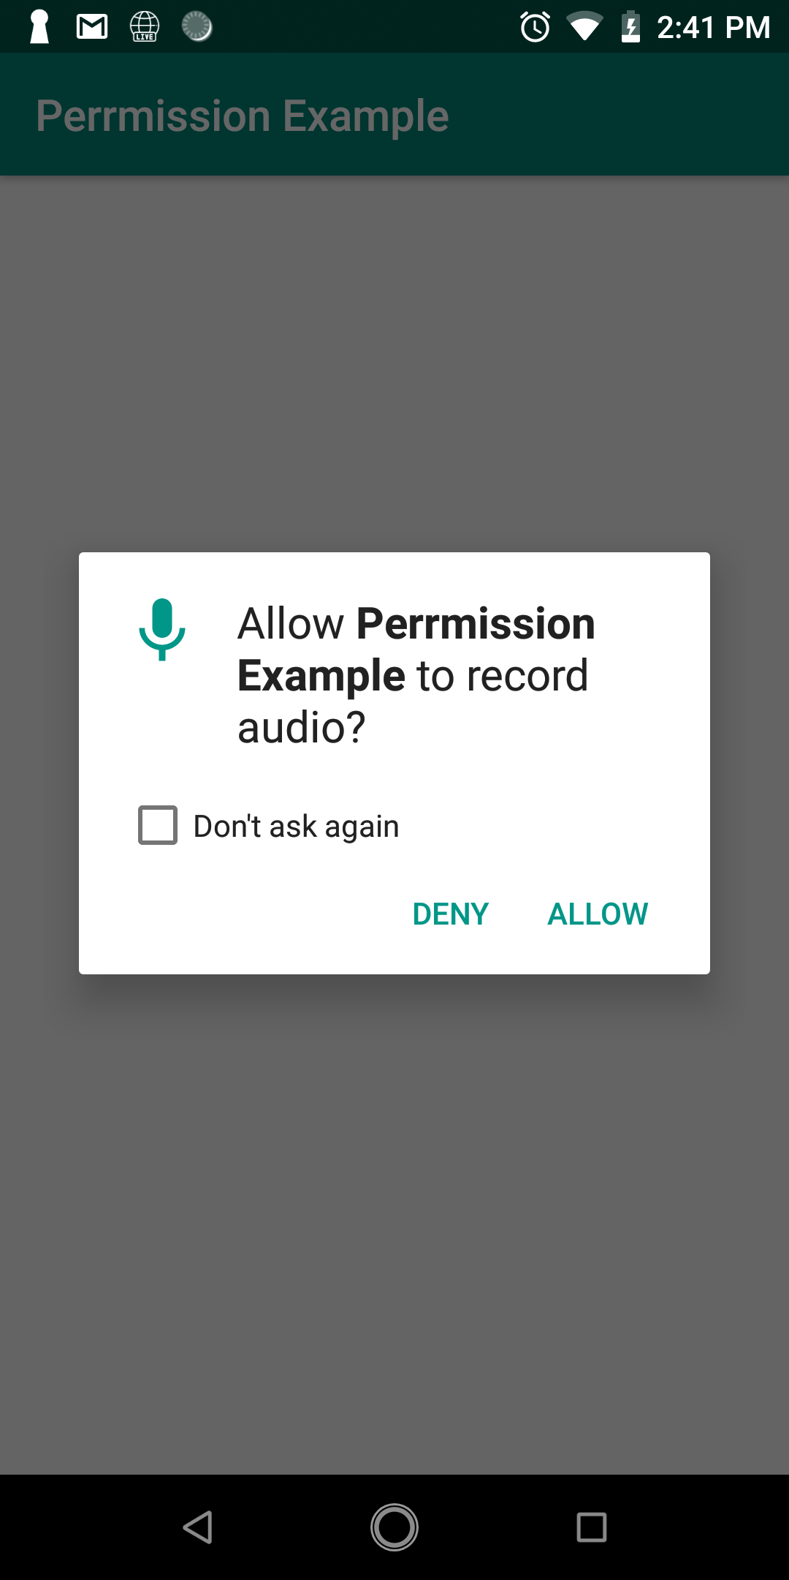
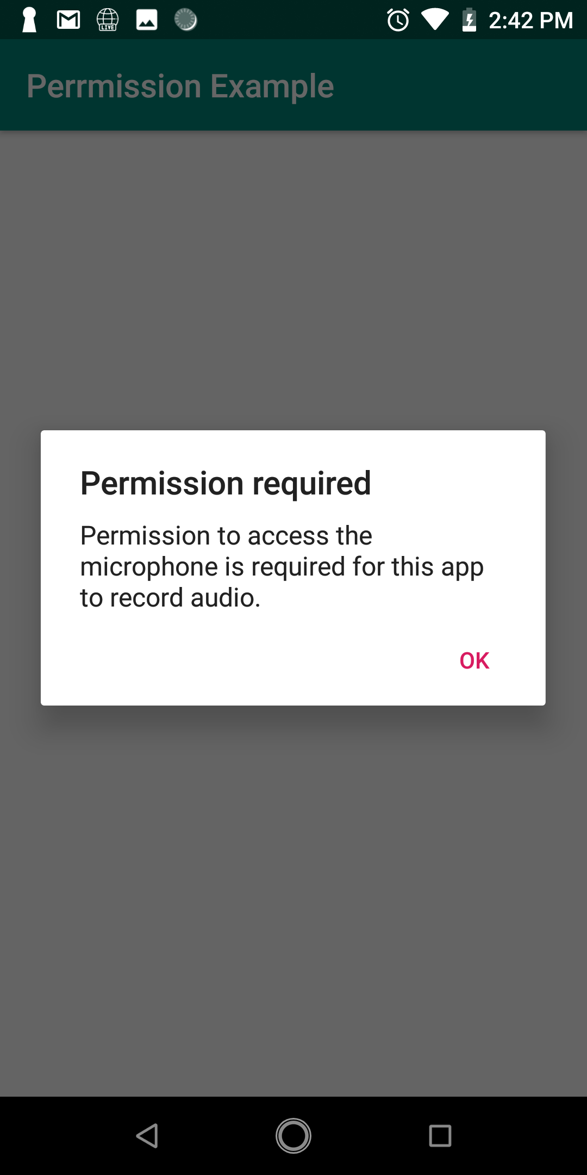
Permission Requests
Testing application

Slide 15
Permission Requests
Testing for other permissions
Calendar | READ_CALENDAR WRITE_CALENDAR
Camera | CAMERA
Phone | READ_PHONE_STATE CALL_PHONE READ_CALL_LOG WRITE_CALL_LOG USE_SIP PROCESS_OUTGOING_CALLS
Microphone | RECORD_AUDIO
Contacts | READ_CONTACTS WRITE_CONTACTS GET_ACCOUNTS
Location | ACCESS_FINE_LOCATION ACCESS_COARSE_LOCATION
Sensors | BODY_SENSORS
SMS | SEND_SMS RECEIVE_SMS READ_SMS RECEIVE_WAP_PUSH RECEIVE_MMS
Storage | READ_EXTERNAL_STORAGE WRITE_EXTERNAL_STORAGE

Slide 16
Audio Recording and Playback
Playing Audio
Most implementations of Android support AAC LC/LTP, HE-AACv1 (AAC+), HE-AACv2 (enhanced AAC+), AMR-NB, AMR-WB, MP3, MIDI, Ogg Vorbis, and PCM/WAVE formats.
Audio playback can be performed using either the MediaPlayer or the AudioTrack classes.
Notes:
AudioTrack is a more advanced option that uses streaming audio buffers and provides greater control over the audio. The MediaPlayer class, on the other hand, provides an easier programming interface for implementing audio playback and will meet the needs of most audio requirements.

Slide 17
Audio Recording and Playback
The MediaPlayer class methods · create() · setDataSource() · prepare() · start() · pause() · stop() · setVolume() · resume() · reset() · release()
Notes:
The MediaPlayer class methods · create() – Called to create a new instance of the class, passing through the Uri of the audio to be played. · setDataSource() – Sets the source from which the audio is to play. · prepare() – Instructs the player to prepare to begin playback. · start() – Starts the playback. · pause() – Pauses the playback. Playback may be resumed via a call to the resume() method. · stop() – Stops playback. · setVolume() – Takes two floating-point arguments specifying the playback volume for the left and right channels. · resume() – Resumes a previously paused playback session. · reset() – Resets the state of the media player instance. Essentially sets the instance back to the uninitialized state. At a minimum, a reset player will need to have the data source set again and the prepare() method called. · release() – To be called when the player instance is no longer needed. This method ensures that any resources held by the player are released.

Slide 18
Audio Recording and Playback
Recording Audio and Video using the MediaRecorder As with audio playback, recording can be performed using a number of different techniques. One option is to use the MediaRecorder class, which, as with the MediaPlayer class, provides a number of methods that are used to record audio

Slide 19
Audio Recording and Playback
MediaPlayer class provides a number methods that are used to record audio
setAudioSource() setVideoSource() setOutputFormat() setAudioEncoder() setOutputFile() | prepare() start() stop() reset() release()
Notes:
- setAudioSource() – Specifies the source of the audio to be recorded (typically this will be MediaRecorder.AudioSource.MIC for the device microphone). - setVideoSource() – Specifies the source of the video to be recorded (for example MediaRecorder.VideoSource.CAMERA). - setOutputFormat() – Specifies the format into which the recorded audio or video is to be stored (for example MediaRecorder.OutputFormat.AAC_ADTS). - setAudioEncoder() – Specifies the audio encoder to be used for the recorded audio (for example MediaRecorder.AudioEncoder.AAC). - setOutputFile() – Configures the path to the file into which the recorded audio or video is to be stored. - prepare() – Prepares the MediaRecorder instance to begin recording. - start() - Begins the recording process. - stop() – Stops the recording process. Once a recorder has been stopped, it will need to be completely reconfigured and prepared before being restarted. - reset() – Resets the recorder. The instance will need to be completely reconfigured and prepared before being restarted. - release() – Should be called when the recorder instance is no longer needed. This method ensures all resources held by the instance are released.

Slide 20
Audio Recording and Playback
Permissions
In order to record audio, the manifest file for the application must include :
android.permission.RECORD_AUDIO
Permisson to store recorded file is: android.permission.WRITE_EXTERNAL_STORAGE

Slide 21
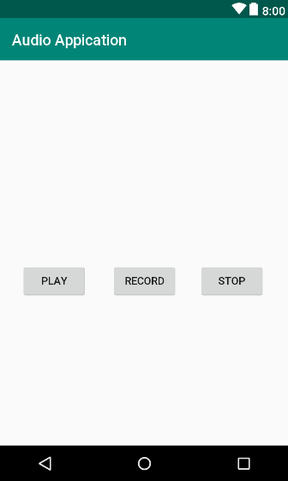
Audio Recording and Playback
Creating the Audio Example Project

Slide 22
Audio Recording and Playback
Checking for Microphone Availability
private boolean hasMicrophone(){ return this.getPackageManager().
hasSystemFeature(PackageManager.FEATURE_MICROPHONE); }

Slide 23
Audio Recording and Playback
Performing the Activity Initialization
playButton = findViewById(R.id.playButton); recordButton = findViewById(R.id.recordButton); stopButton = findViewById(R.id.stopButton); playButton.setEnabled(false); stopButton.setEnabled(false); if(!hasMicrophone()){ message += "System micro phone not available"; recordButton.setEnabled(false); } audioFilePath = Environment.getExternalStorageDirectory().getAbsolutePath() + "/myAudio.3gp";

Slide 24
Audio Recording and Playback
Implementing the recordAudio() Method
public void recordOnClick(View view) { isRecording = true; recordButton.setEnabled(false); stopButton.setEnabled(true); playButton.setEnabled(false); try { mediaRecorder = new MediaRecorder(); mediaRecorder.setAudioSource(MediaRecorder.AudioSource.MIC); mediaRecorder.setOutputFormat(MediaRecorder.OutputFormat.THREE_GPP); mediaRecorder.setOutputFile(audioFilePath); mediaRecorder.setAudioEncoder(MediaRecorder.AudioEncoder.AMR_NB); mediaRecorder.prepare(); mediaRecorder.start(); }catch (Exception e){ } }

Slide 25
Audio Recording and Playback
Implementing the stopAudio() Method
public void stopOnClick(View view) { if(isRecording){ mediaRecorder.stop(); mediaRecorder.release(); mediaRecorder = null; isRecording = false; } else { mediaPlayer.release(); mediaPlayer = null; recordButton.setEnabled(true); } playButton.setEnabled(true); stopButton.setEnabled(false); }

Slide 26
Audio Recording and Playback
Implementing the playAudio() method
public void playOnClick(View view) { try { stopButton.setEnabled(true); recordButton.setEnabled(false); playButton.setEnabled(false); mediaPlayer = new MediaPlayer(); mediaPlayer.setDataSource(audioFilePath); mediaPlayer.prepare(); mediaPlayer.start(); }catch (Exception e){ } }

Slide 27
Audio Recording and Playback
Adding Permission in Manifest file
<uses-permission android:name="android.permission.RECORD_AUDIO"/> <uses-permission android:name="android.permission.READ_EXTERNAL_STORAGE"/> <uses-permission android:name="android.permission.WRITE_EXTERNAL_STORAGE"/>
int PERMISSION_ALL = 1; private void requestPermission(){ String[] PERMISSIONS = { Manifest.permission.RECORD_AUDIO, Manifest.permission.READ_EXTERNAL_STORAGE, Manifest.permission.WRITE_EXTERNAL_STORAGE }; ActivityCompat.requestPermissions(this, PERMISSIONS, PERMISSION_ALL); }

Slide 28
Audio Recording and Playback
Testing the Application

Slide 29

End of Lesson 19

Slide 30
Thank you!

